Slide 1
Software task
explanation of the design patterns ,architectural patterns ,SOLID ,Test driven.

Slide 2
Design Patterns
are typical solutions to common problems in software design. Each pattern is like a blueprint that you can customize to solve a particular design problem in your code.

Slide 3
Design patterns
C
S
B
Creational Design
Structural Design
Behavioral Design
Creational design patterns provide various object creation mechanisms, which increase flexibility and reuse of existing code.
Structural design patterns explain how to assemble objects and classes into larger structures, while keeping these structures flexible and efficient.
Behavioral design patterns are concerned with algorithms and the assignment of responsibilities between objects.

Slide 4
Creational Design
Creational design patterns provide various object creation mechanisms, which increase flexibility and reuse of existing code.
1
Singleton
is a creational design pattern that lets you ensure that a class has only one instance, while providing a global access point to this instance.
2
Prototype
is a creational design pattern that lets you copy existing objects without making your code dependent on their classes.

Slide 5
Creational Design
3
Builder
is a creational design pattern that lets you construct complex objects step by step. The pattern allows you to produce different types and representations of an object using the same construction code.
4
Abstract Factory
is a creational design pattern that lets you produce families of related objects without specifying their concrete classes.
5
Factory Method
is a creational design pattern that provides an interface for creating objects in a superclass, but allows subclasses to alter the type of objects that will be created.

Slide 6
Structural Design
Structural design patterns explain how to assemble objects and classes into larger structures, while keeping these structures flexible and efficient.
1
Adapter
is a structural design pattern that allows objects with incompatible interfaces to collaborate.
2
Bridge
is a structural design pattern that lets you split a large class or a set of closely related classes into two separate hierarchies—abstraction and implementation—which can be developed independently of each other.

Slide 7
Structural Design
3
Facade
is a structural design pattern that provides a simplified interface to a library, a framework, or any other complex set of classes.
4
Decorator
is a structural design pattern that lets you attach new behaviors to objects by placing these objects inside special wrapper objects that contain the behaviors.
5
Composite
is a structural design pattern that lets you compose objects into tree structures and then work with these structures as if they were individual objects.

Slide 8
Structural Design
6
Flyweight
is a structural design pattern that lets you fit more objects into the available amount of RAM by sharing common parts of state between multiple objects instead of keeping all of the data in each object.
7
Proxy
is a structural design pattern that lets you provide a substitute or placeholder for another object. A proxy controls access to the original object, allowing you to perform something either before or after the request gets through to the original object.

Slide 9
Behavioral Design
Behavioral design patterns are concerned with algorithms and the assignment of responsibilities between objects.
1
Chain of Responsibility
is a behavioral design pattern that lets you pass requests along a chain of handlers. Upon receiving a request, each handler decides either to process the request or to pass it to the next handler in the chain.
2
Command
is a behavioral design pattern that turns a request into a stand-alone object that contains all information about the request. This transformation lets you pass requests as a method arguments, delay or queue a request’s execution, and support undoable operations.

Slide 10
Behavioral Design
3
Iterator
is a behavioral design pattern that lets you traverse elements of a collection without exposing its underlying representation (list, stack, tree, etc.).
4
Mediator
is a behavioral design pattern that lets you reduce chaotic dependencies between objects. The pattern restricts direct communications between the objects and forces them to collaborate only via a mediator object.
5
Memento
is a behavioral design pattern that lets you save and restore the previous state of an object without revealing the details of its implementation.

Slide 11
Behavioral Design
6
Observer
is a behavioral design pattern that lets you define a subscription mechanism to notify multiple objects about any events that happen to the object they’re observing.
7
State
is a behavioral design pattern that lets an object alter its behavior when its internal state changes. It appears as if the object changed its class.
8
Strategy
is a behavioral design pattern that lets you define a family of algorithms, put each of them into a separate class, and make their objects interchangeable.

Slide 12
Behavioral Design
9
Template Method
is a behavioral design pattern that defines the skeleton of an algorithm in the superclass but lets subclasses override specific steps of the algorithm without changing its structure.
0
Visitor
is a behavioral design pattern that lets you separate algorithms from the objects on which they operate.

Slide 13
Architectural pattern
A collection of architectural design choices meant to tackle common design issues in different software development scenarios is called an architectural pattern.

Slide 14
Architectural pattern
1
2
Layered style
Client server mode
3
4
Micro-kernel
MVPMicro-services
5
6
MVC
MVP
7
MVVM

Slide 15
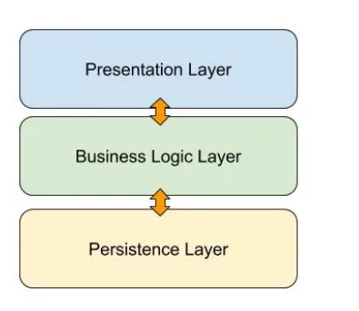
Layered architecture style
The layered architecture style is a software design pattern where multiple layers are used for specific functions, allowing for maintenance and development without affecting others.
Usage:
1.Applications that are needed to be built quickly.
2.require traditional IT
3. for teams with inexperienced developers and limited knowledge of architecture patterns.

Slide 16
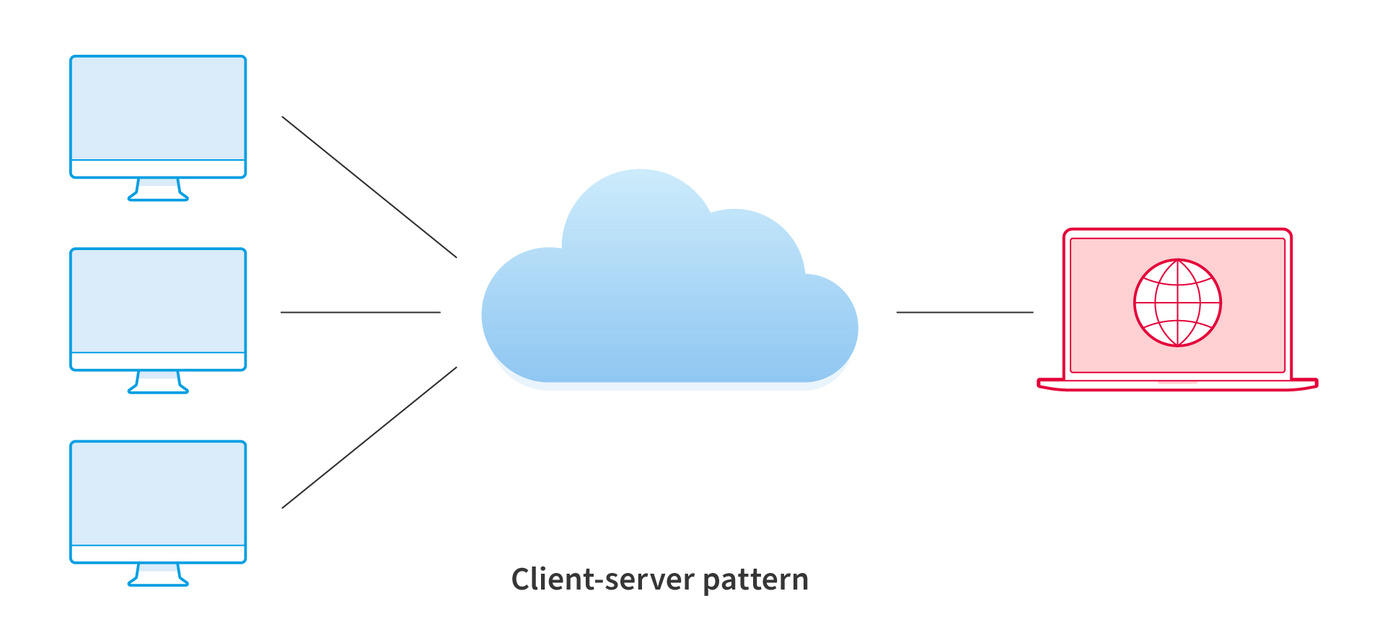
Client server mode
The client-server model is a distributed application structure that divides tasks between servers and clients, often communicating over a computer network on separate hardware, although both may reside in the same system.
Usage:
1.Web Browsing
2.Email Systems
3.Online Gaming
4.Database Management

Slide 17
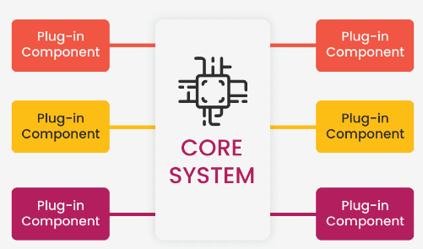
Microkernel Pattern:
The Microkernel Architecture Pattern, also known as the plug-in architecture pattern, is a software design pattern that separates a system's core functionalities from its extended and application-specific parts.
Usage:
1.Applications that have a clear segmentation between basic routines and higher-order
2.applications with a dynamic collection of rules that require regular changes in addition to a fixed set of core operations.
3.Embedded Systems

Slide 18
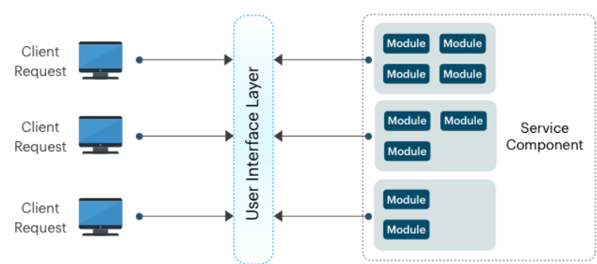
Micro-services architecture
The Microservices Architecture Pattern is a software development approach that consists of small, autonomous services, each implementing a specific business function, aiming for scalable and maintainable applications.
Usage:
1.Businesses and web applications that require rapid development.
2.Websites with small components
3.Banking systems
4.Streaming services

Slide 19
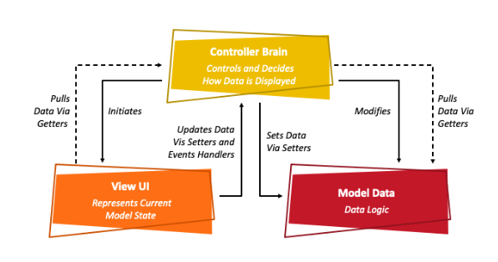
MVC (Model-View-Controller)
Model: Represents the data and business logic of the app
View: Handles the visual presentation of the data.
Controller: Receives user input, updates the model, and instructs the view to update accordingly
Benefits:
Simple and easy to understand.
Suitable for smaller projects.
Drawbacks:
Tight coupling between View and Controller can make code harder to maintain in complex applications
Testing the View can be challengin

Slide 20
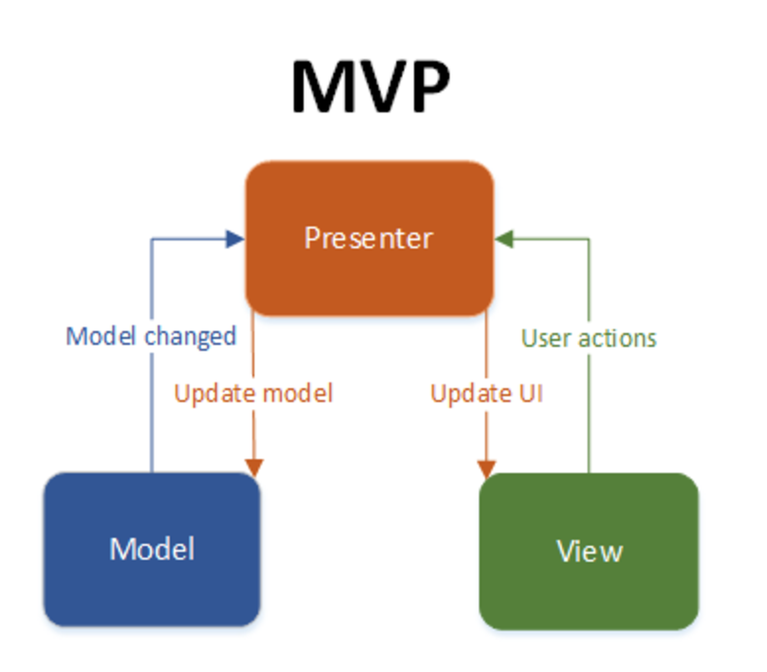
6.MVP (Model-View-Presenter)
Model: Represents the data and business logic of the app
View: Similar to MVC, but it doesn't directly interact with the Model or perform any business logic
Presenter: Acts as an intermediary between the View and Model. It receives user input from the View, updates the Model, retrieves data from the Model, and formats it for the View
Benefits:
Improved separation of concerns compared to MVC
Easier to test the View and Presenter independently
Drawbacks:
Introduces an extra layer of complexity (Presenter) compared to MVC
Can lead to boilerplate code for simple tasks

Slide 21
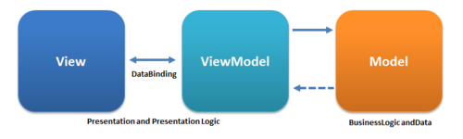
MVVM (Model-View-ViewModel)
ViewMode: Acts as a bridge between the View and Model. It exposes data from the Model in a way that's easily consumable by the View, and handles user input events, notifying the Model of changes. Additionally, the ViewModel can handle some presentation logic
Model: Represents the data and business logic of the app
View: Similar to MVC and MVP, focuses on presentation.
Benefits:
Excellent separation of concerns, promoting loose coupling and testability.
Well-suited for complex UIs with data binding frameworks
Drawbacks:
Most complex pattern among the three, requiring a steeper learning curve
Can be overkill for simple applications

Slide 22
SOLID Principles
When designing software, it’s important to think about scalability and maintainability as the application grows

Slide 23
SOLID Principles
1
2
Single Responsibility Principle (SRP)
Open-Closed Principle (OCP)
3
4
Liskov Substitution Principle (LSP)
Interface Segregation Principle (ISP)
5
Dependency Inversion Principle (DIP)

Slide 24
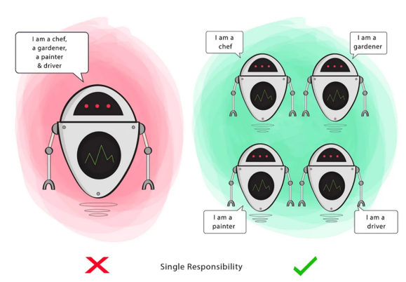
Single Responsibility Principle (SRP)
The Single Responsibility Principle (SRP) encourages a class or module to change for one good reason, enhancing code modularity, making it easier to understand and maintain.

Slide 25
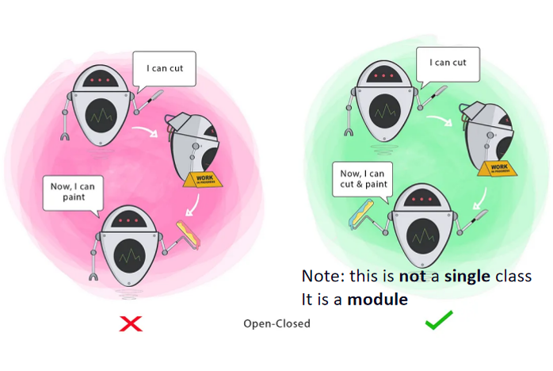
Open-Closed Principle (OCP)
The Open-Closed Principle suggests that software entities should be closed for modification but open for extension, allowing for the extension of a class's behavior without necessitating modifications. allows for minimal editing of existing code, allowing for the addition of new features without excessive or no editing, thereby facilitating effective implementation.

Slide 26
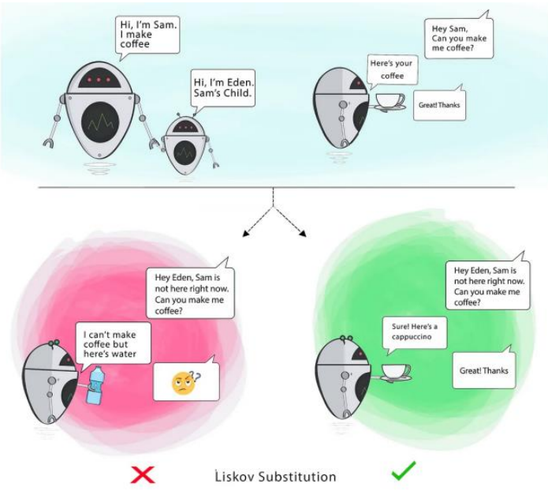
Liskov Substitution Principle (LSP)
According to the Liskov Substitution Principle, instances of an object's sub-type should be able to replace it in a program without changing the program's correctness. Stated otherwise, the code should allow a subclass to take the place of its parent class without causing any issues.

Slide 27
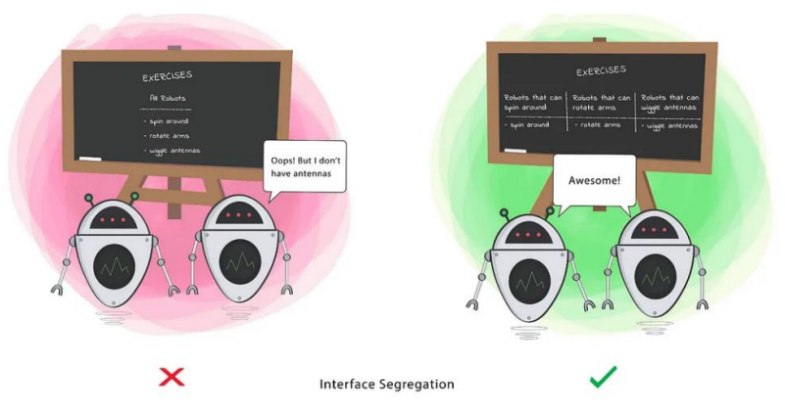
Interface Segregation Principle (ISP)
According to the Interface Segregation Principle, customers shouldn't be made to rely on techniques they don't employ. This implies that you shouldn't be forced to use techniques that you don't require.

Slide 28
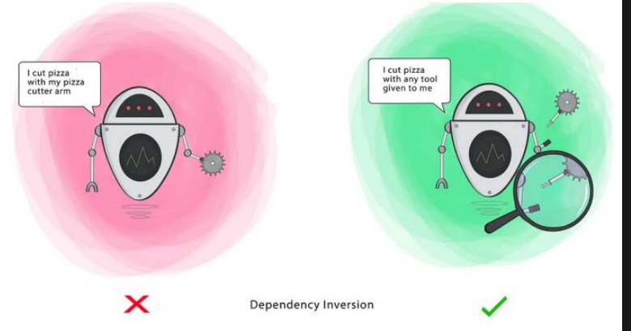
Dependency Inversion Principle (DIP)
According to the Dependency Inversion Principle, abstractions should be the source of dependency for both high-level and low-level modules instead of the other way around. This implies that if a module's implementation changes, you shouldn't need to modify your code.

Slide 29
Single Responsibility Principle (SRP)
The Single Responsibility Principle (SRP) encourages a class or module to change for one good reason, enhancing code modularity, making it easier to understand and maintain.

Slide 30


Test Driven
TDD is a software development method that involves creating and testing function test cases before writing code, aiming to simplify and eliminate errors.

Slide 31
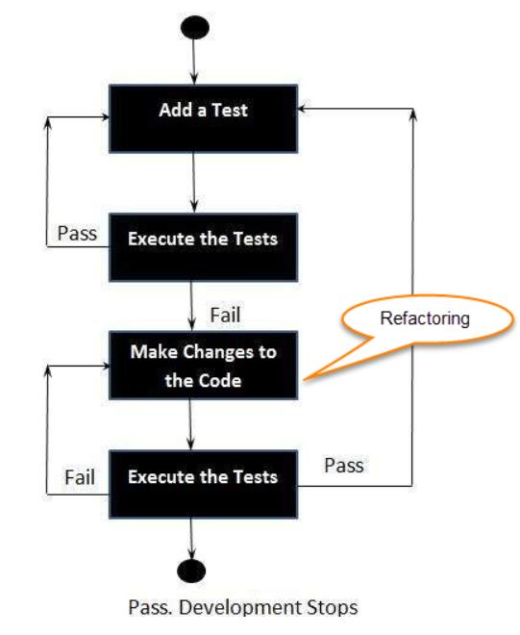

How to perform a TDD test
1.Add a test.
2.Run all the tests and see if any new test fails.
3.Write some code.
4.Run tests and Refactor code.
5.Repeat

Slide 32
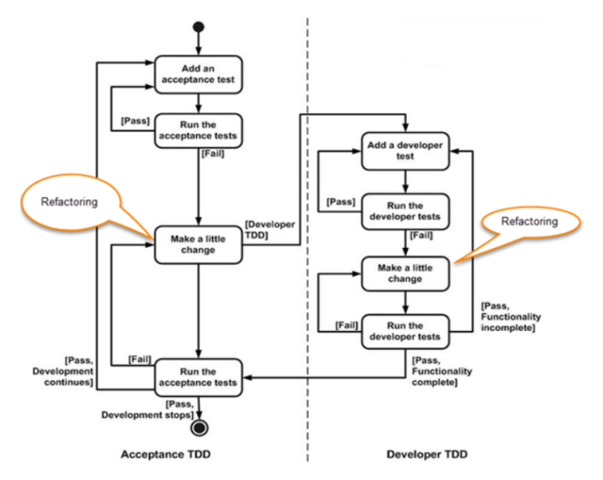
What is TDD Acceptance and TDD Developer?
Accept TDD (ATDD/BDD) :- Writing a single acceptance test that satisfies the requirements of the specification or satisfies the behavior of the system, and then writing a sufficient amount of code to satisfy that test. Acceptance testing focuses on the overall behavior of the system.
Developer TDD :- involves writing a single unit test and writing code to pass the test. Unit testing focuses on a small function in the system. The goal of ATDD and TDD is to achieve detailed, actionable requirements and implement the solution in a timely manner, focusing only on the required requirements to increase efficiency.

Slide 33
TDD advantages: TDD disadvantages:
•Improved code quality
•Faster debugging
•Design improvement
•Regression testing
•Initial time investment
•Learning curve
•Overemphasis on test coverage
•Maintenance overhead

Slide 34
THANKS FOR WATCHING
Created by:
1. Amr mohamed khalafalla
2. mohamed khaled ghareb
3. Ahmed elsayed saad

